Slide 1

ROAD HEALTH DAIGNOSTIC SYSTEM
FIRST EVALUATION
INDEX
INTRODUCTION
TEAM INTRODUCTION
PROJECT INTRODUCTION
ENGINEERING IN OUR PROJECT
AN ABSTRACT VIEW
DETAILED VIEW OF SUB PARTS
PROTOTYPE STAGE
OUR PRESENTATION TO SIH
By – Team CLASSIFIED

Slide 2

TEAM CLASSIFIED
RIDHAM BHAT
TEAM LEAD
NAMAN JAIN
TEAM MEMBER
SAYANTANU DEY
TEAM MEMBER
VEDANT AGGARWAL
TEAM MEMBER
NIKHIL RAGHAV
TEAM MEMBER
RIYA KHAZANCHI
TEAM MEMBER
THIS WAY

Slide 3
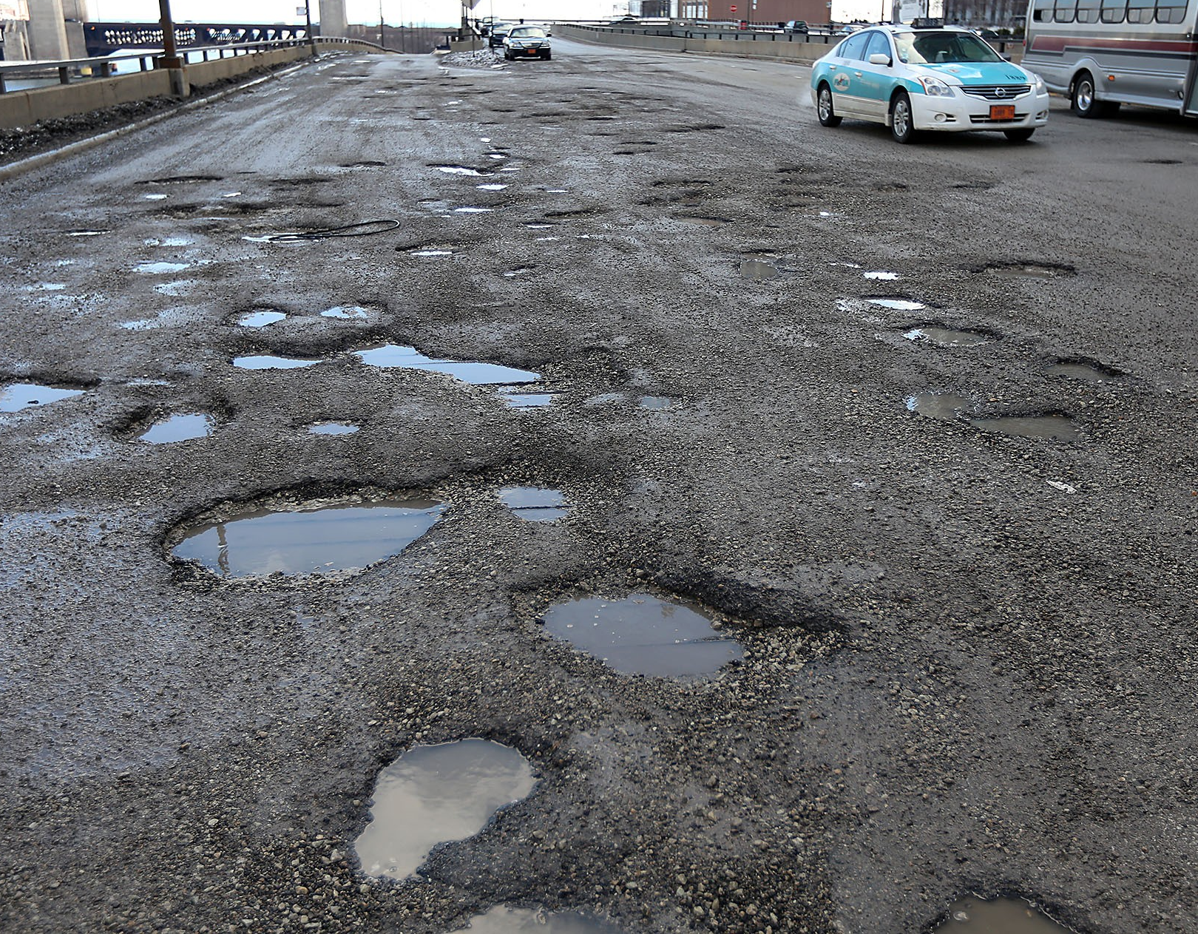
PROJECT INTRODUCTION:
PROBLEMS WE FACE :: India has a total of about 2 million kilometers of roads , out of which about 1 million are poorly constructed (with dents, potholes, broken parts). These road conditions lead to severe problems like (Accidents, Traffic, Water clogging, Damage to vehicle, Poor aesthetics etc.), This not only affects our economy but our image on the global scale. Despite huge expenditure on road repair by government, Delayed actions by Authorities due to insufficient data about road condition delay its solution.
“ Diagnosis is the first step towards cure ”
AN AUTOMATIC REVIEW SYSTEM OF ROADS BY ITS USERS (CAR)

Slide 4
“ Diagnosis is the first step towards cure ”
AN AUTOMATIC REVIEW SYSTEM OF ROADS BY ITS USERS (CAR)

Slide 5
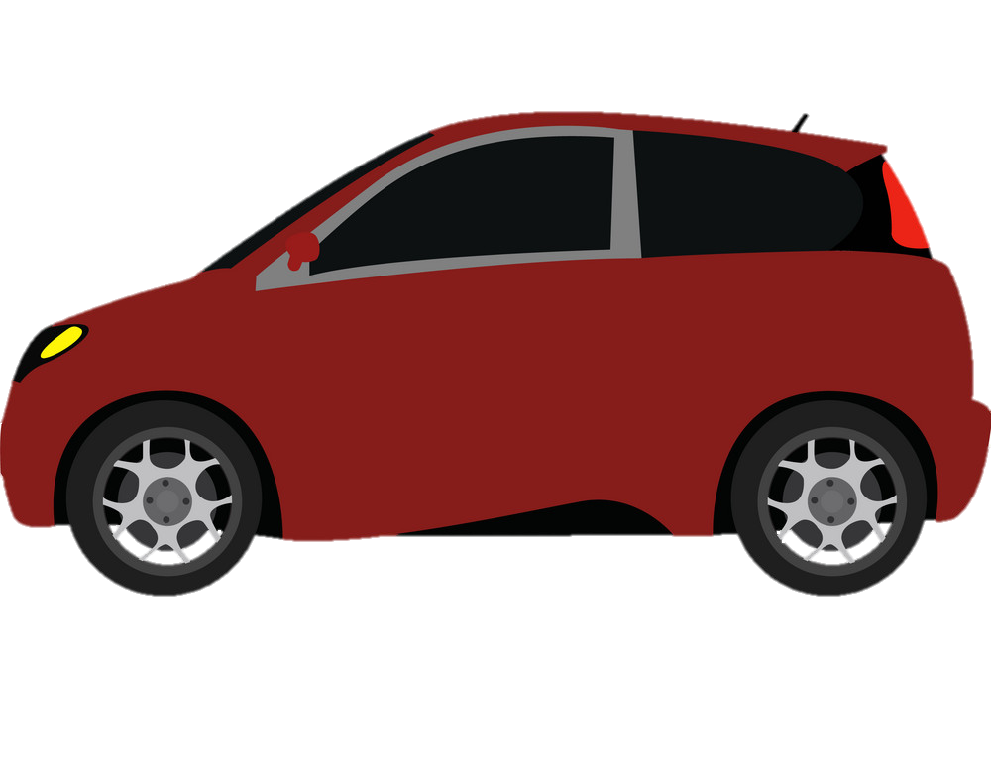

THE ENGINEERING PART
IMPLEMENTING IT PROFFESIONALLY
x-axis
y-axis
z-axis

Slide 6
AN ABSTRACT VIEW
ROAD TO A SOLUTION
DATABASE
APPLICTAIONS
GOVERNMENT ACCOUNTABILITY
A SELF UPDATING MAP OF ROAD HEALTH (CONDITION)
REPAIR COST ESTIMATION
A DATABASE FOR RESEARCH
DATABASE UPDATE MECHANISM
DRIVING HELP ON GOOGLE MAPS
SMARTPHONE AS SENSOR
REVERSE CAR HEALTH MAPPING
CORE OF THE PROJECT
SENSOR MODULE IN CAR
FUTURE APPLICTAIONS
ON BOARD CAMERA
SELF DRIVING CAR , POTHOLE AVOIDANCE
AERIAL/SATELITE IMAGERY

Slide 7
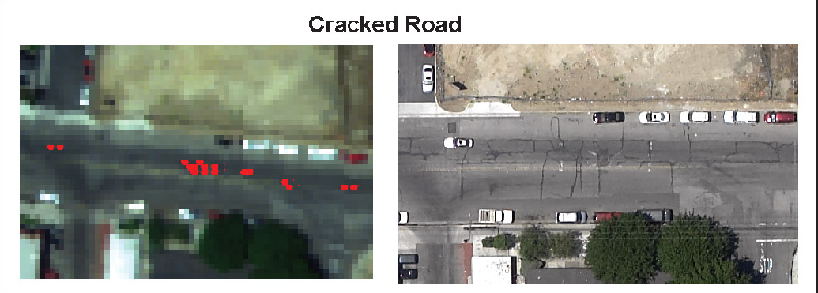
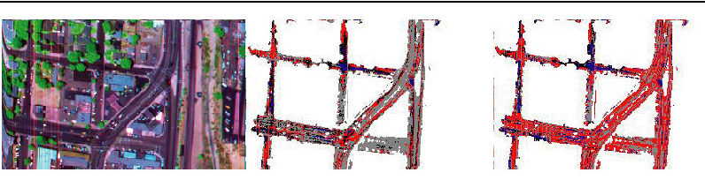

DATABASE UPDATE MECHANISM
AERIAL/SATELITE IMAGERY
Satelite : Rapidly scalable – very long update time – clear resolution not available
Aerial : not scalable – clear image quality – lower update time means more hassles
SENSOR MODULE IN CAR
Satelite : not very scalable – fixed module - can be fine tuned to every car – clear resolution not available

Slide 8
DATABASE UPDATE MECHANISM
ON BOARD IMAGE PROCESSING
NOT scalable – night time detection problems – image of potholes available – complete system will be expensive – may mark potholes that do not cause porblems
SMARTPHONE AS SENSOR
Scalable – can be fine tuned to every car – actual pothole experience through mems sensors

Slide 9

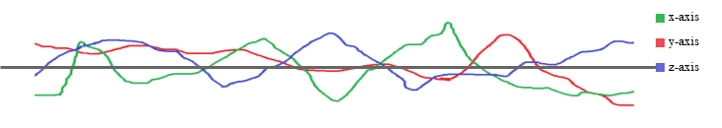
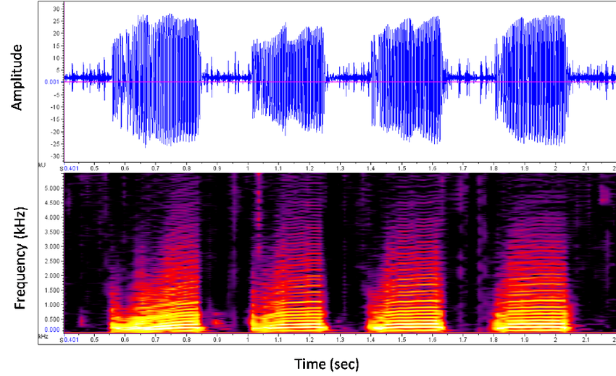
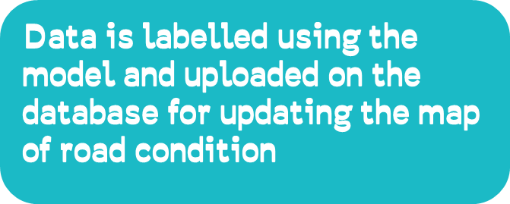
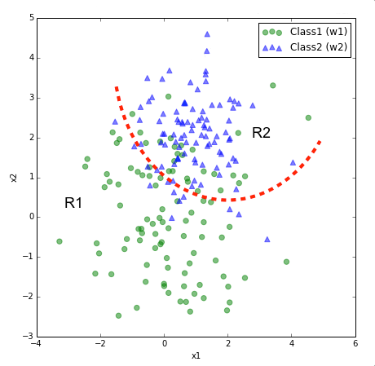

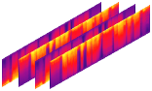



SMART PHONE AS SENSOR – BASIC FLOW CHART
SYSTEM ON CAR
LABELLING
GPS
DATA TO BE TRANSFERRED TO MAIN SERVER
MULTI CAR STATISTICS
ROAD HEALTH MAP

Slide 10
SMART PHONE AS SENSOR
SYSTEM ON CAR
CAR VARIATIONS
Road Load Simulation Using Effective Road Profile 971512
This reearch presents a concept using effective road profile to calculate road loads. The method uses existing vehicle road load data, simplified vehicle dynamic model and simple tire model to create effective road profile. Then the simplified vehicle model is updated to reflect the vehicle changes of a new vehicle. Run the simplified new vehicle model to calculate road loads. The application of effective road profile in laboratory simulation is introduced. Preliminary CAE road load simulation using the effective road profile is presented.
LABELLING
GPS
DATA TO BE TRANSFERRED TO MAIN SERVER
MULTI CAR STATISTICS
ROAD HUMP / POTHOLE SEPRATE USING ACCELEROMETER GRAPHS

Slide 11
MULTI CAR STATISTICS

Slide 12
LABELLING

Slide 13
APPLICATIONS
Applications: 1.government accountability + REPAIR COST PREDICTION 2.road health on Google Maps 3.reverse car health mapping 4.database for research purposes

Slide 14
IMPLEMENTATION
CAB SERVICES ARE THE BEST CANDIDATE FOR A SCALABE USE
AERIAL IMAGERY (INITIAL DATA)
AERIAL IMAGERY (INITIAL DATA)

Slide 15
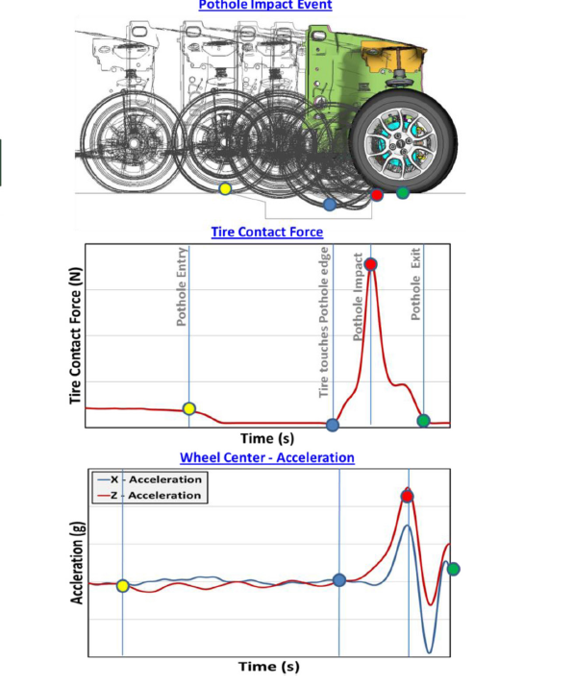
PROTOTYPE
VIRTUAL PROTO-DATABASE
APPLICATION INTERFACE
INDEPENDENT APPLICATION
SIMULATION

